Slide 1
Health care website
Heart care
Home
About Us
Services
Appointment
The center
Contact
Team Members:
N.SAINATHREDDY (2010030320)
N.MAHENDRANATH REDDY (2010030233)
S.INDRA REDDY (2010030159)
S. SAI SANTHOSH REDDY (2010030145)

Slide 2
Heart care website:
Heart care
Home
About Us
Services
Appointment
The center
Contact
In this website we can add the doctors of worldwide And patients can apply appointments for specific heart disease, and patients can also check the availability of cardiologist and get information about department services and provide special treatments and patients are going to Contact doctors using social media. There is also having feedback, appointments, data of doctors and customers and many more can be controlled. It also has email sending feature using which users receive email after contacting to the related authority
Heart care
080-369416665544

Slide 3
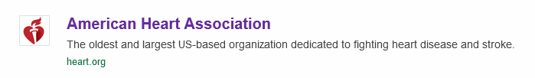
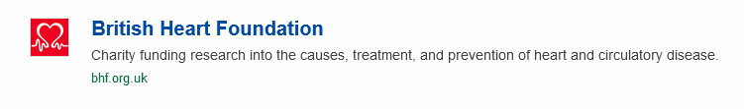
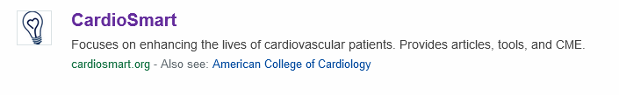
Existing heart care websites:
Heart care
Home
About Us
Services
Appointment
The center
Contact
Heart care
080-369416665544

Slide 4


Strengths of Heart care websites:
Heart care
Home
About Us
Services
Appointment
The center
Contact
As of now there is now heart related websites there in India there are some websites are like “Heart care India co” and “heart care foundation” –founder “Sreesanth cricketer”
New things that are included in our project are:
Education: Heart care websites provide a wealth of information about heart health, including risk factors, symptoms of heart disease, treatment options
Heart care
080-369416665544

Slide 5
Heart care
Home
About Us
Services
Appointment
The center
Contact
Accessibility: Heart care websites are accessible to anyone with an internet connection, which can be particularly helpful for individuals who live in remote areas or have mobility issues
Support: Heart care websites often provide resources and support for individuals living with heart disease or recovering from heart-related procedures
Convenience: Heart care websites make it easy to find and book appointments with heart specialists, access medical records, and communicate with healthcare providers
Personalization: Some heart care websites offer personalized content and tools, such as risk assessments and tracking tools that are not providing on our website
Heart care
080-369416665544

Slide 6
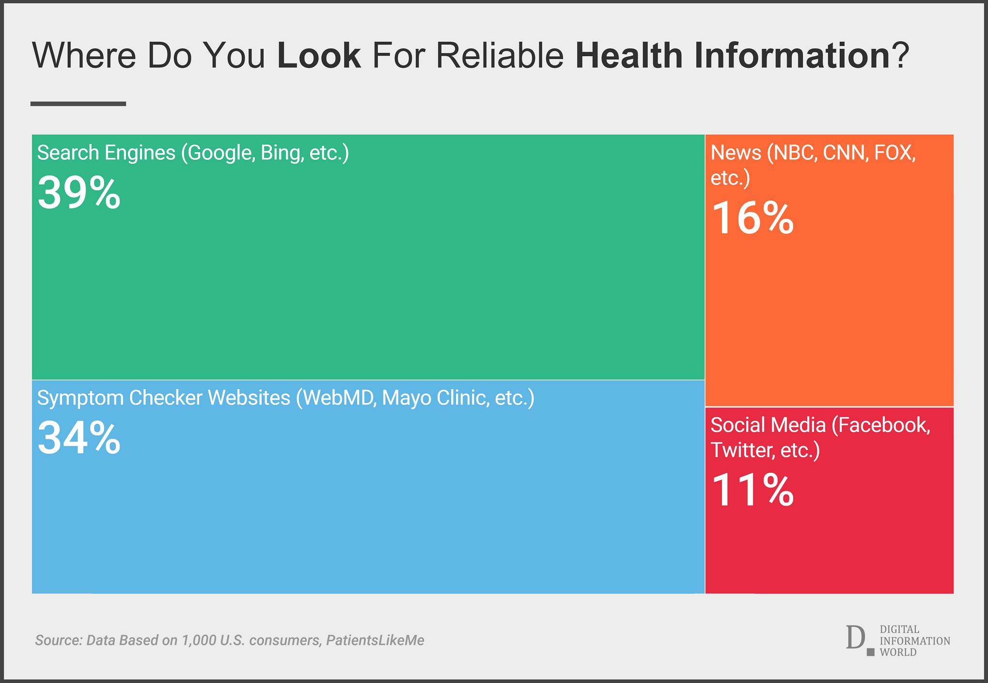
Heart care
Home
About Us
Services
Appointment
The center
Contact
People usage heartcare websites:
Heart care
080-369416665544

Slide 7
Heart care
Home
About Us
Services
Appointment
The center
Contact
Strategies and initial fundings needed
Education and Awareness: Heart care websites provide educational resources, articles, and infographics to help users learn about various heart-related conditions, symptoms, risk factors, and treatments
User-Friendly Interface: Heart care websites are designed to be user-friendly, with easy-to-navigate interfaces, clear and concise language, and engaging visuals to help users better understand complex medical terms and concepts.
Mobile Access: Heart care websites often have mobile applications that allow users to access information and resources on the go and track their health-related data
Heart care
080-369416665544

Slide 8
Heart care
Home
About Us
Services
Appointment
The center
Contact
Fundings needed for websites
Initially website needs some front-end developers and back-end developers based on requirements we hire them
Based on government authorization we can get access all the hospital doctor’s data
As of the website creation we can get the certain backend developed companies to store the data
After completion we can publish the websites using search engines and televisions so take more time to get permission from governament
Heart care
080-369416665544

